Slide 1
Retail Sales Dashboard in Excel
Demo Data

Slide 2
Problem Statement
This Retail store wants to create an annual report for the year 2022,
So that they can understand the buying pattern of their customers and grow more sales in upcoming year.

Slide 3
Key Questions
Compare sales and orders using single chart.
Which Month got the highest sales and orders?
Who purchased more Men or Women in 2022?
What are the different order status in 2022?
Which channel contributed more in 2022?
What was highest selling category in 2022?

Slide 4
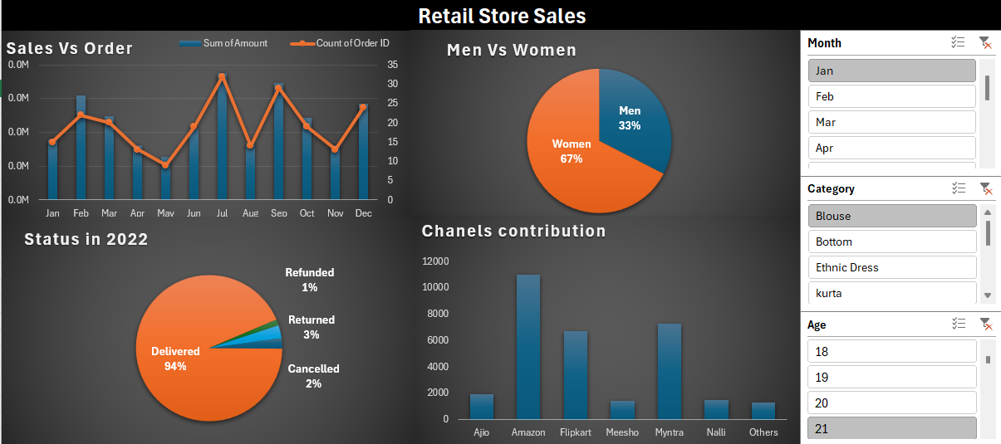
Dashboard

Slide 5
Conclusion
The above dashboard answers all the questions regarding the sales of that retail store as per asked by the company and the data provided, this will help them to understand the order of buying according to category, age and gender.

